Slide 2
LINQ - Language Integrated Query

Slide 3
LINQ
LINQ stands for Language Integrated Query
LINQ (Language Integrated Query) is uniform query syntax in C# to save and retrieve data from different sources.
One of the central, and most important, features of LINQ is its integration of a flexible query syntax into the C# language.
Write queries against in-memory collections and other queryable sources using LINQ.
Write data access code directly against a Microsoft SQL Server database by using LINQ to SQL
Write data access code for XML data by using LINQ to XML
Write common data access code across different data providers and storage schemas by using LINQ to Entities
Write rich queries against data in a Microsoft DataSet by using LINQ to DataSet

Slide 4
The LINQ
C#
VB
Others
LINQ to Objects
LINQ to DataSets
LINQ to SQL
LINQ to Entities
LINQ to XML
<book>
<title/>
<author/>
<year/>
<price/>
</book>
Objects
Relational
XML

Slide 5
Query Expressions
Project | Select <expr>, Return <expr>
Filter | Where <expr>, Distinct
Test | Any(<expr>), All(<expr>)
Join | <expr> Join <expr> On <expr> = <expr>
Group | Group By <expr>, <expr> Aggregate <expr>, <expr> Group Join <decl> On <expr> = <expr> Aggregate <expr>
Aggregate | Count(<expr>), Sum(<expr>), Min(<expr>), Max(<expr>), Avg(<expr>), Group(<expr>)…
Partition | Skip [ While ] <expr>, Take [ While ] <expr>
Set | Union, Intersect, Except
Order | Order By <expr>, <expr>

Slide 6
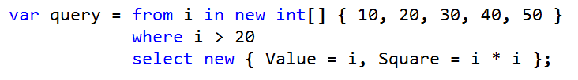
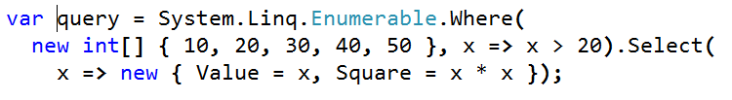
Syntax Types
Query Syntax
Method Syntax

Slide 7
LINQ Queries
Query is an expression that retrieves data from a data source.
Queries are usually expressed in a specialized query language
Different languages have been developed over time for the various types of data sources, for example SQL for relational databases and XQuery for XML.
LINQ offers a consistent model for working with data across various kinds of data sources and formats.
All LINQ query operations consist of three distinct actions:
Obtain the data source.
Create the query.
Execute the query.
Query is executed in a foreach statement, and foreach requires IEnumerable or IEnumerable<T>.

Slide 8
Before LINQ
class Program
{
static void Main(string[] args)
{
Student[] studentArray = {
new Student() { StudentID = 1, StudentName = "John", Age = 18 },
new Student() { StudentID = 2, StudentName = "Steve", Age = 21 },
new Student() { StudentID = 3, StudentName = "Bill", Age = 25 },
new Student() { StudentID = 4, StudentName = "Ram" , Age = 20 },
new Student() { StudentID = 5, StudentName = "Ron" , Age = 31 },
new Student() { StudentID = 6, StudentName = "Chris", Age = 17 },
new Student() { StudentID = 7, StudentName = "Rob",Age = 19 },
};
class Student
{
public int StudentID { get; set; }
public String StudentName { get; set; }
public int Age { get; set; }
}

Slide 9
Student[] students = new Student[10];
int i = 0;
foreach (Student std in studentArray)
{
if (std.Age > 12 && std.Age < 20)
{
students[i] = std;
i++;
}
}
}
}

Slide 10
After Linq
// Use LINQ to find teenager students
Student[] teenAgerStudents = studentArray.Where(s => s.age > 12 && s.age < 20).ToArray();
// Use LINQ to find first student whose name is Bill
Student bill = studentArray.Where(s => s.StudentName == "Bill").FirstOrDefault();
// Use LINQ to find student whose StudentID is 5
Student student5 = studentArray.Where(s => s.StudentID == 5).FirstOrDefault();

Slide 11
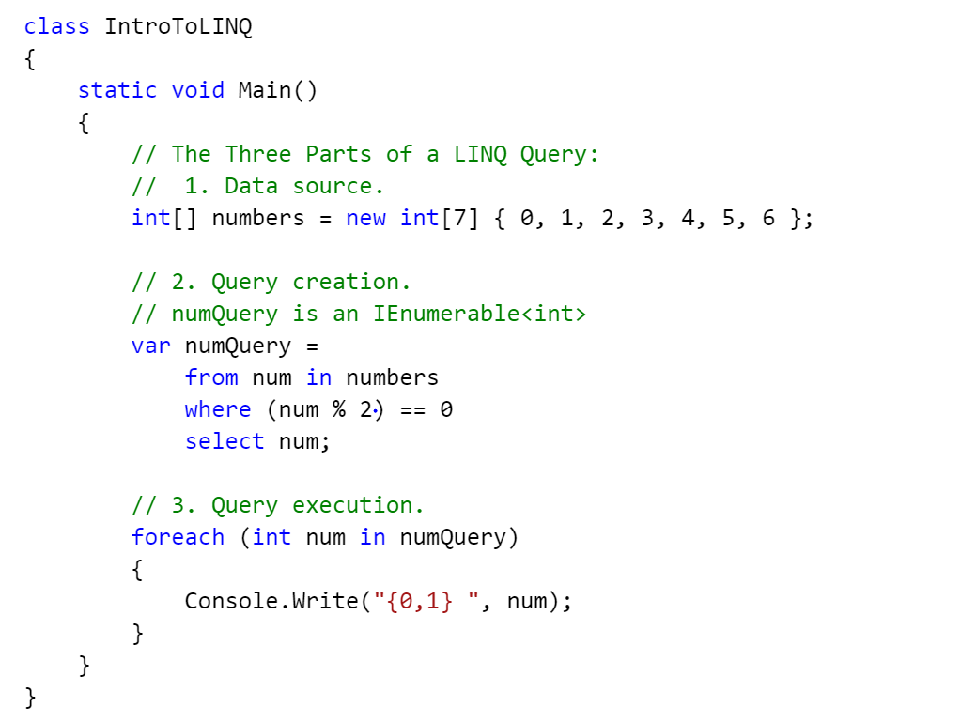
Example

Slide 12
Pictorial Form
Data Source
Item 1
Item 2
Item 3
Item 4
Query
from..
Where..
Select…
Query Execution
Get data
for each (var item in Query)
Do something with item Get next item

Slide 13
Deferred Execution
A query variable only stores the query commands. The actual execution of the query is deferred until you iterate over the query variable in a for each statement.
This concept is considered as deferred execution.
Deferred execution can greatly improve performance when you have to manipulate large data collections.
The collection results will have smaller memory foot prints.

Slide 14
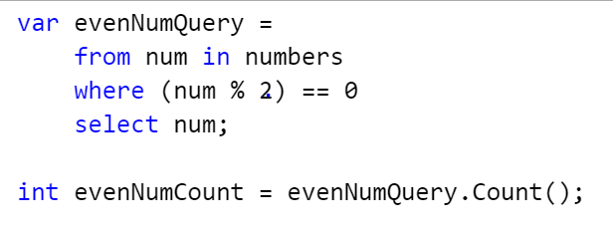
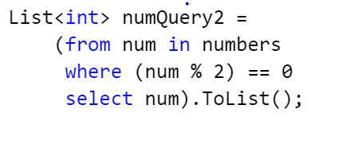
Forcing Immediate Execution
Queries that perform aggregation functions over a range of source elements must first iterate over those elements.
Examples of such queries are Count, Max, Average, and First. These execute without an explicit foreach statement because the query itself must use foreach in order to return a result.
To force immediate execution of any query and cache its results, you can call the ToList<TSource> or ToArray<TSource> methods.

Slide 15
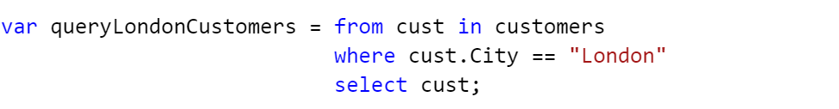
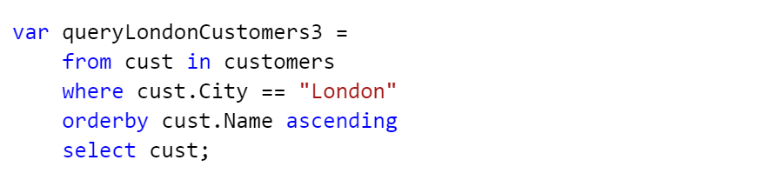
Query Operations:
Filtering
Ordering

Slide 16
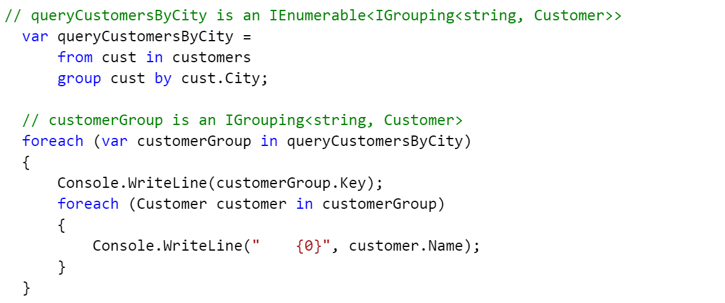
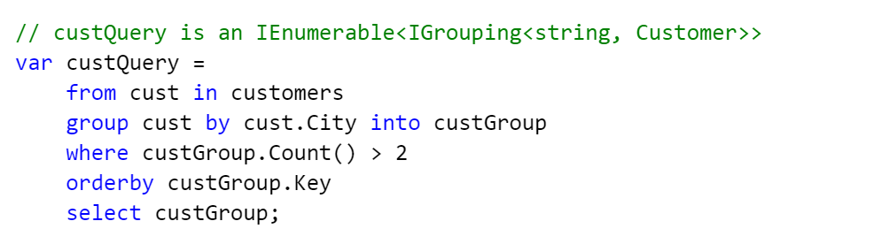
Query Operations:
Grouping

Slide 17
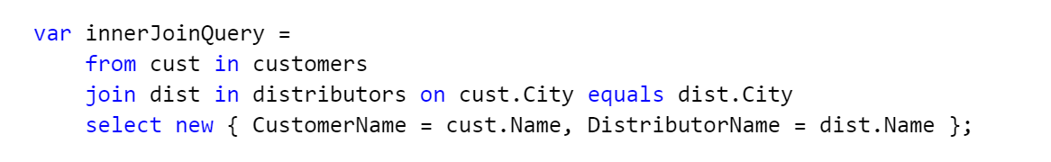
Query Operations:
Joining

Slide 18
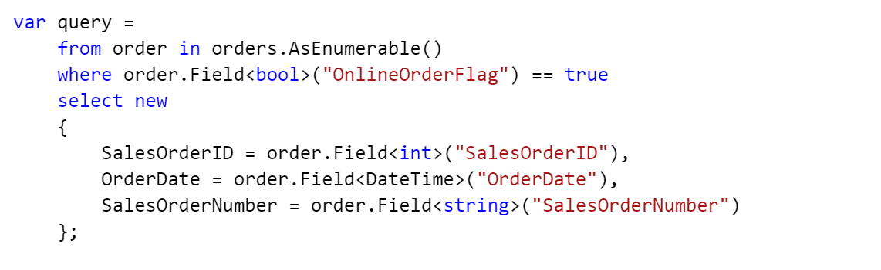
LINQ To Dataset
LINQ to DataSet makes it easier and faster to query over data cached in a DataSet object.
The DataTable class does not implement either interface, so you must call the AsEnumerable method if you want to use the DataTable as a source in the From clause of a LINQ query

Slide 19
LINQ To XML
LINQ to XML is a LINQ-enabled, in-memory XML programming interface that enables you to work with XML from within the .NET Framework programming languages.
LINQ to XML is like the Document Object Model (DOM) in that it brings the XML document into memory. You can query and modify the document, and after you modify it you can save it to a file or serialize it and send it over the Internet.
However, LINQ to XML differs from DOM: It provides a new object model that is lighter weight and easier to work with, and that takes advantage of language improvements in Visual C#.

Slide 20
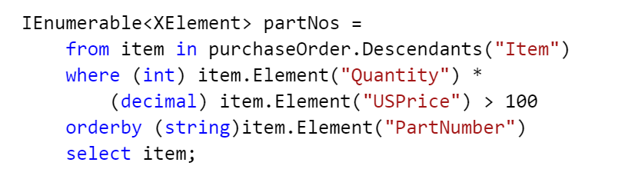
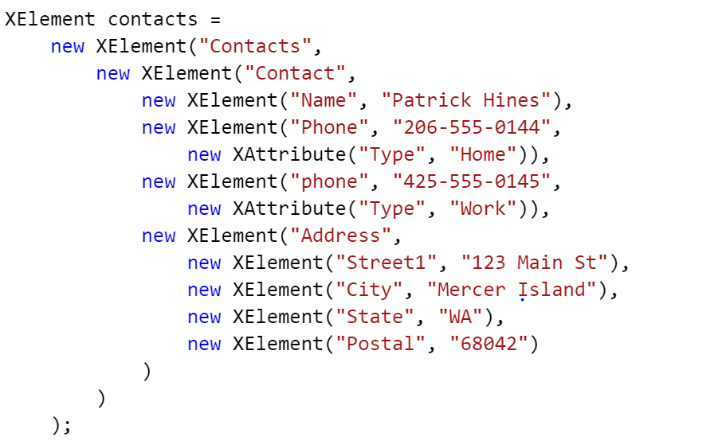
Example:

Slide 21
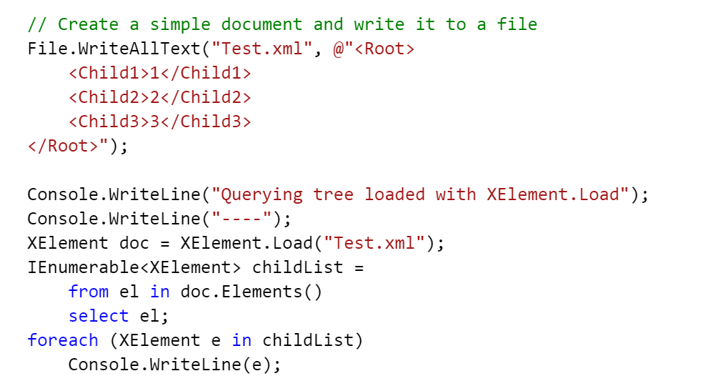
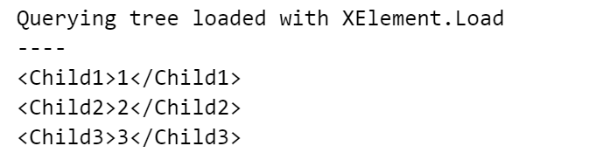
Example: XElement

Slide 22
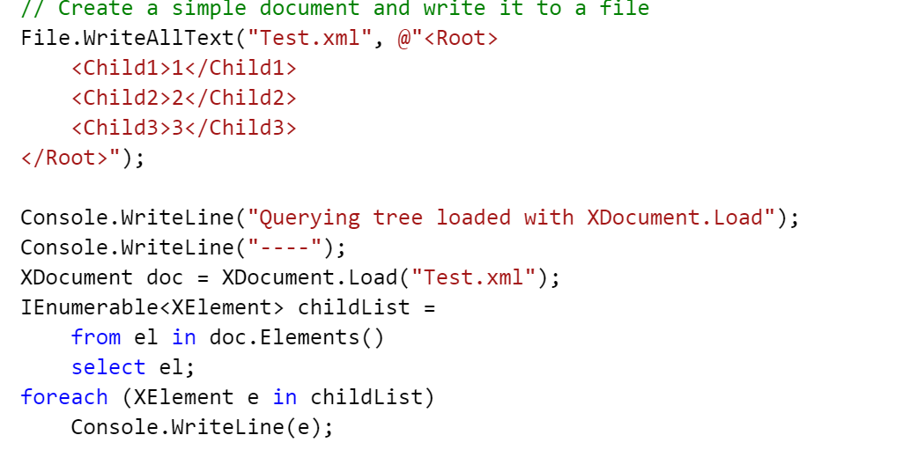
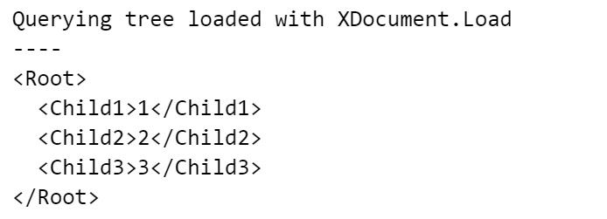
Example: XDocument.

Slide 23
Xdocument vs XElement
When you load an XML document into an XElement via XElement.Load, the XElement at the root of the XML tree contains the root element of the loaded document. However, when you load the same XML document into an XDocument via XDocument.Load, the root of the tree is an XDocument node, and the root element of the loaded document is the one allowed child XElement node of the XDocument. The LINQ to XML axes operate relative to the root node.

Slide 24
LINQ Samples
https://code.msdn.microsoft.com/101-LINQ-Samples-3fb9811b

Slide 25
Thank You

